Slide 1
Kinematics of Belt and Gear Driven Systems
Dr. Jacob Moore
Associate Professor of Engineering
Penn State Mont Alto

Slide 2
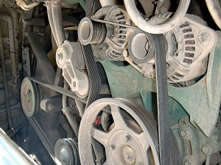
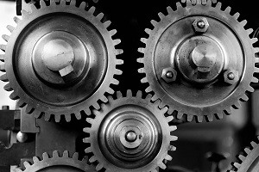
Belt and Gear Driven Systems
Belt or gear driven systems have fixed axis pulleys or gears where motion is transferred (via a belt or teeth) from one axis to another.

Slide 3
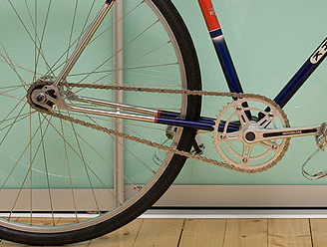
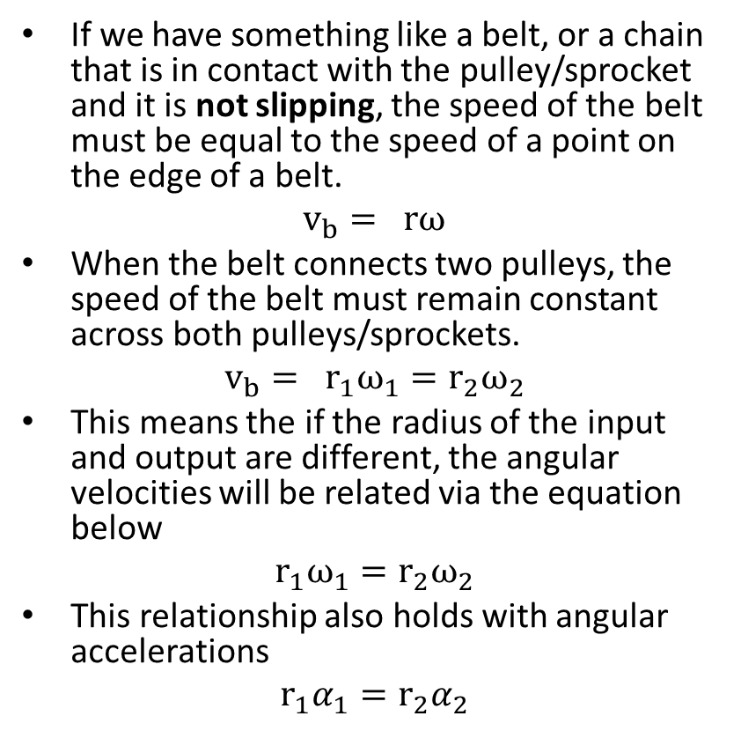
Belt or Chain Driven Systems
If we have something like a belt, or a chain that is in contact with the pulley/sprocket and it is not slipping, the speed of the belt must be equal to the speed of a point on the edge of a belt.
$$v_{b}= rω$$
When the belt connects two pulleys, the speed of the belt must remain constant across both pulleys/sprockets.
$$v_{b}= r_{1}ω_{1}=r_{2}ω_{2}$$
This means the if the radius of the input and output are different, the angular velocities will be related via the equation below
$$r_{1}ω_{1}=r_{2}ω_{2}$$
This relationship also holds with angular accelerations
$$r_{1}α_{1}=r_{2}α_{2}$$
Image licensed under a CC-BY 2.0 license by
Moebiusuibeom-en

Slide 4
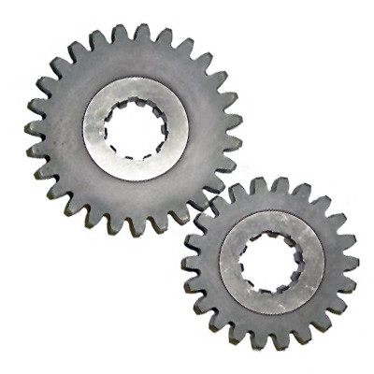
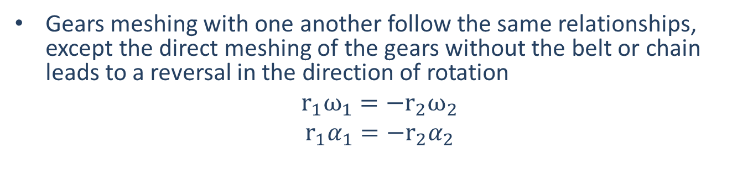
Gear Driven Systems
Gears meshing with one another follow the same relationships, except the direct meshing of the gears without the belt or chain leads to a reversal in the direction of rotation
$r_{1}ω_{1}=−r_{2}ω_{2}$
$$r_{1}α_{1}=−r_{2}α_{2}$$
Image licensed under a CC-BY 2.0 license by
Moebiusuibeom-en
Image licensed under a CC-BY-SA 2.0 license by AJC1

Slide 5
Complex Belt and Gear Driven Systems
For larger changes in torque and in speed, we often run through a series of pulleys or gears rather than relying on one very big jump.
In these systems, any motion transferred via a belt or meshing teeth will follow the relationships from the previous slides
In these systems, any two pulleys of gears on the same shaft will have the same angular velocity and angular acceleration.

Slide 6
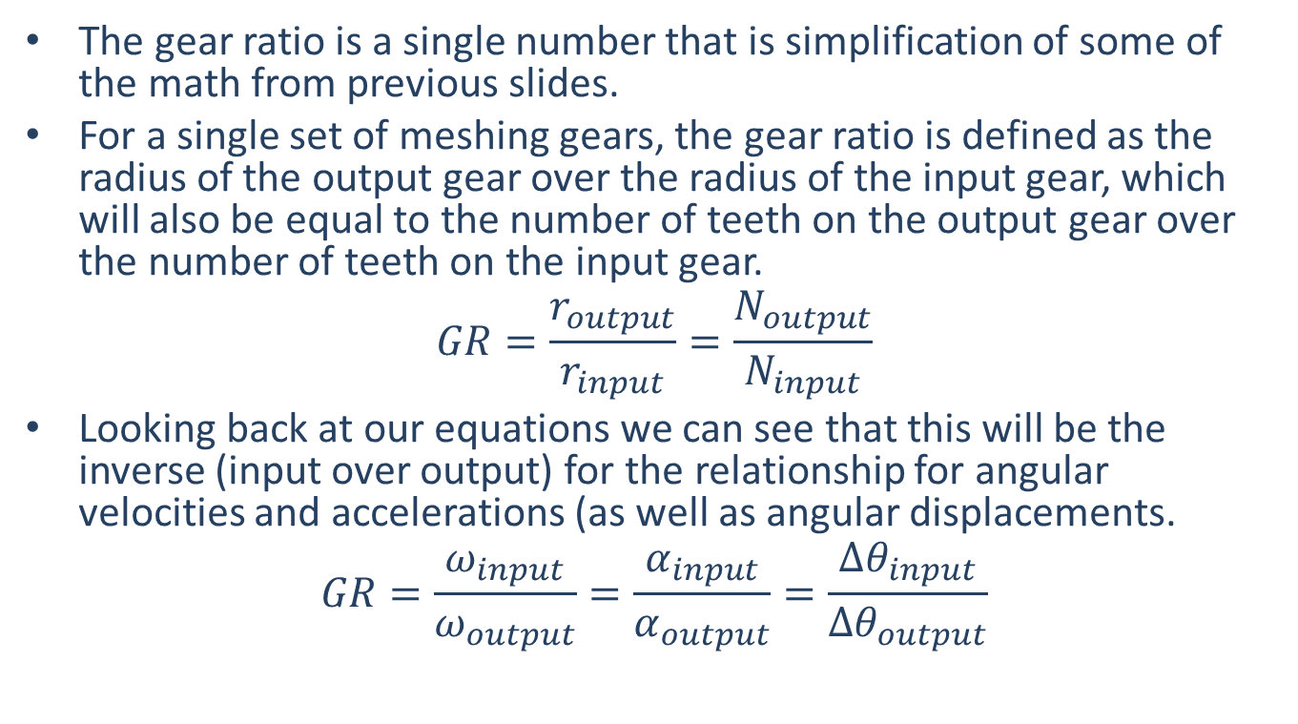
Gear Ratios
The gear ratio is a single number that is simplification of some of the math from previous slides.
For a single set of meshing gears, the gear ratio is defined as the radius of the output gear over the radius of the input gear, which will also be equal to the number of teeth on the output gear over the number of teeth on the input gear.
$$GR=\frac{r_{output}}{r_{input}}=\frac{N_{output}}{N_{input}}$$
Looking back at our equations we can see that this will be the inverse (input over output) for the relationship for angular velocities and accelerations (as well as angular displacements.
$$GR=\frac{ω_{input}}{ω_{output}}=\frac{α_{input}}{α_{output}}=\frac{{∆θ}_{input}}{{∆θ}_{output}}$$

Slide 7
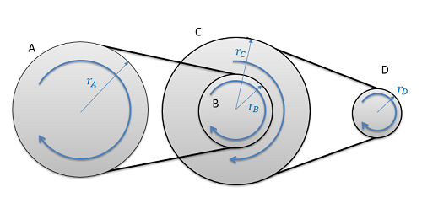
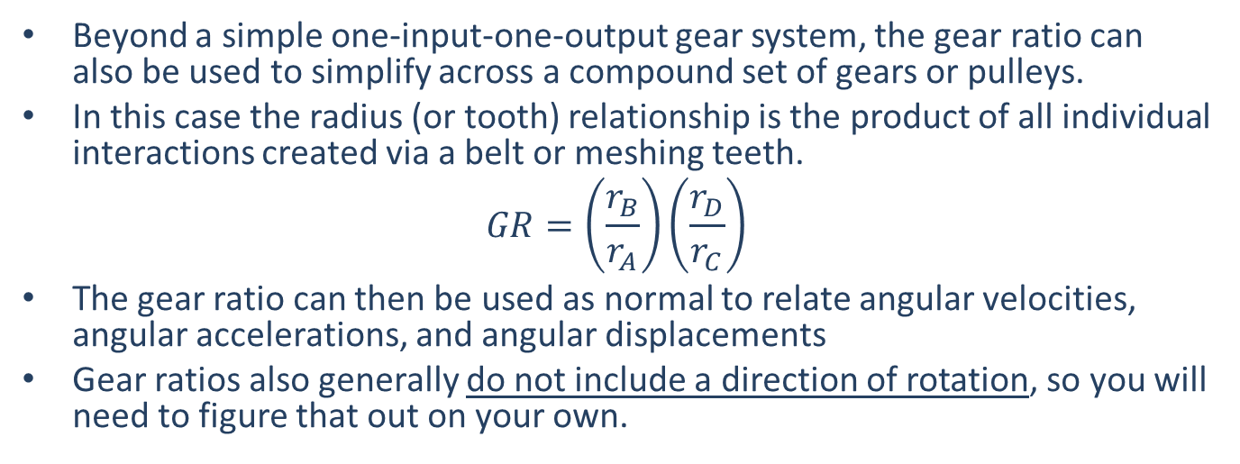
Gear Ratio
Beyond a simple one-input-one-output gear system, the gear ratio can also be used to simplify across a compound set of gears or pulleys.
In this case the radius (or tooth) relationship is the product of all individual interactions created via a belt or meshing teeth.
$$GR=\left(\frac{r_{B}}{r_{A}}\right)\left(\frac{r_{D}}{r_{C}}\right)$$
The gear ratio can then be used as normal to relate angular velocities, angular accelerations, and angular displacements
Gear ratios also generally do not include a direction of rotation, so you will need to figure that out on your own.

Slide 8
Thanks for Watching
See other engineering mechanics videos and access the full tool at…

Slide 9
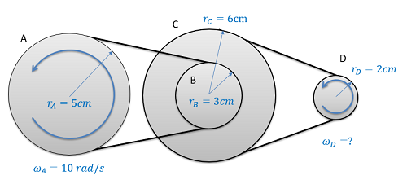
Worked Example
If the input pulley A as shown below is rotating at a rate of 10 rad/s, what is the speed of the output pulley at D? How many rotations does D go through in the time it takes for A to make one full rotation?

Slide 10
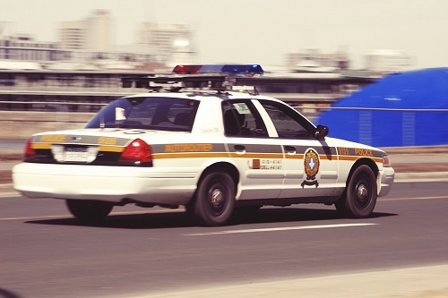
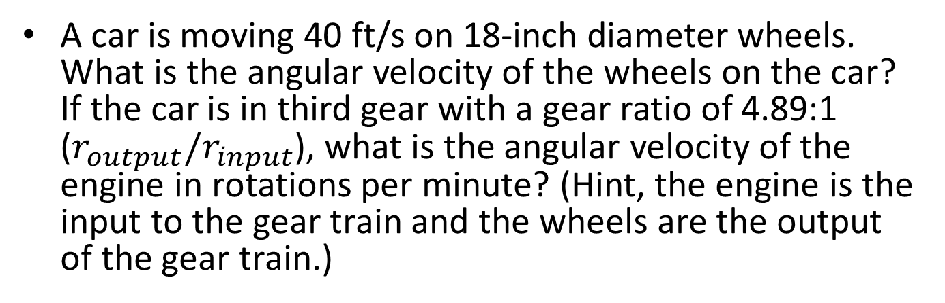
Worked Example
A car is moving 40 ft/s on 18-inch diameter wheels. What is the angular velocity of the wheels on the car? If the car is in third gear with a gear ratio of 4.89:1 ($r_{output}/r_{input}$), what is the angular velocity of the engine in rotations per minute? (Hint, the engine is the input to the gear train and the wheels are the output of the gear train.)

Slide 11
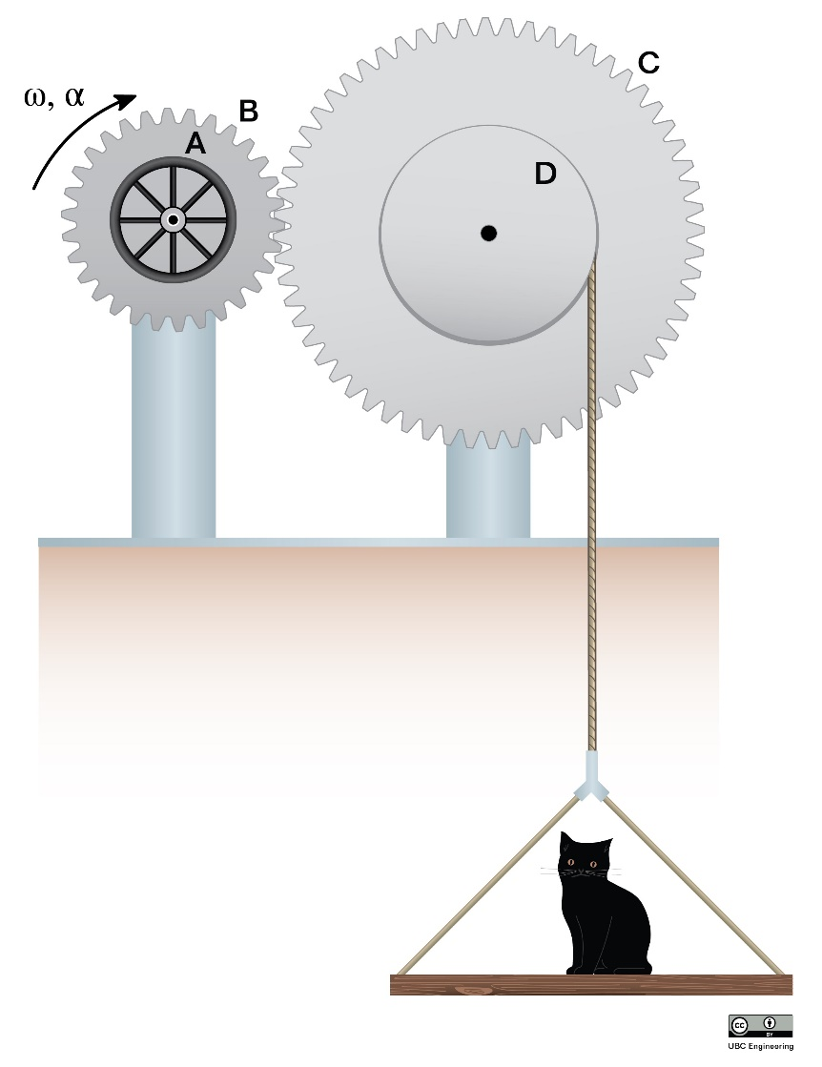
Worked Example
A cat has found itself stuck on a platform controlled by a gear system. A bystander attempts to save it by turning handle A at a constant 5 rad/s2 in the clockwise direction. The diameter of handle A and gear B is 0.3m and 0.6m respectively, and the two are rigidly attached. Gear C has a radius of 0.8m while pulley D has a radius of 0.3m.The cord to which the platform is connected to is wrapped around pulley D which is rigidly attached to gear C. Assume the system starts from rest. a)Determine the velocity of the cat and the distance it travels in 5 seconds. b)If the cat gets motion sickness and cannot handle an acceleration of 3m/s2 upwards, what is the maximum angular acceleration the bystander can turn the handle at? Are they currently over or under the limit?

Slide 12
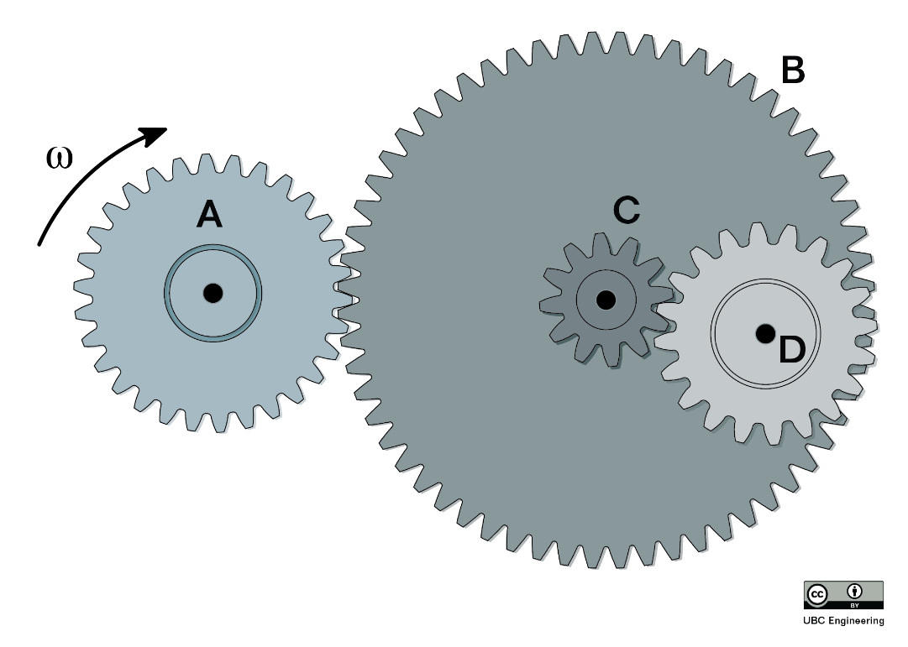
Worked Example
In the following gear train, gear A is in contact with gear B. Gear B and gear C are rigidly attached, and gear C is in contact with gear D. If gear A rotates at an angular velocity of 5 rad/s in the clockwise direction, what is the magnitude of the angular velocity of gear D? r_{A}=1m, r_{B}=3m, r_{C}=0.5m, r_{D}=1.5m

